Slide 1
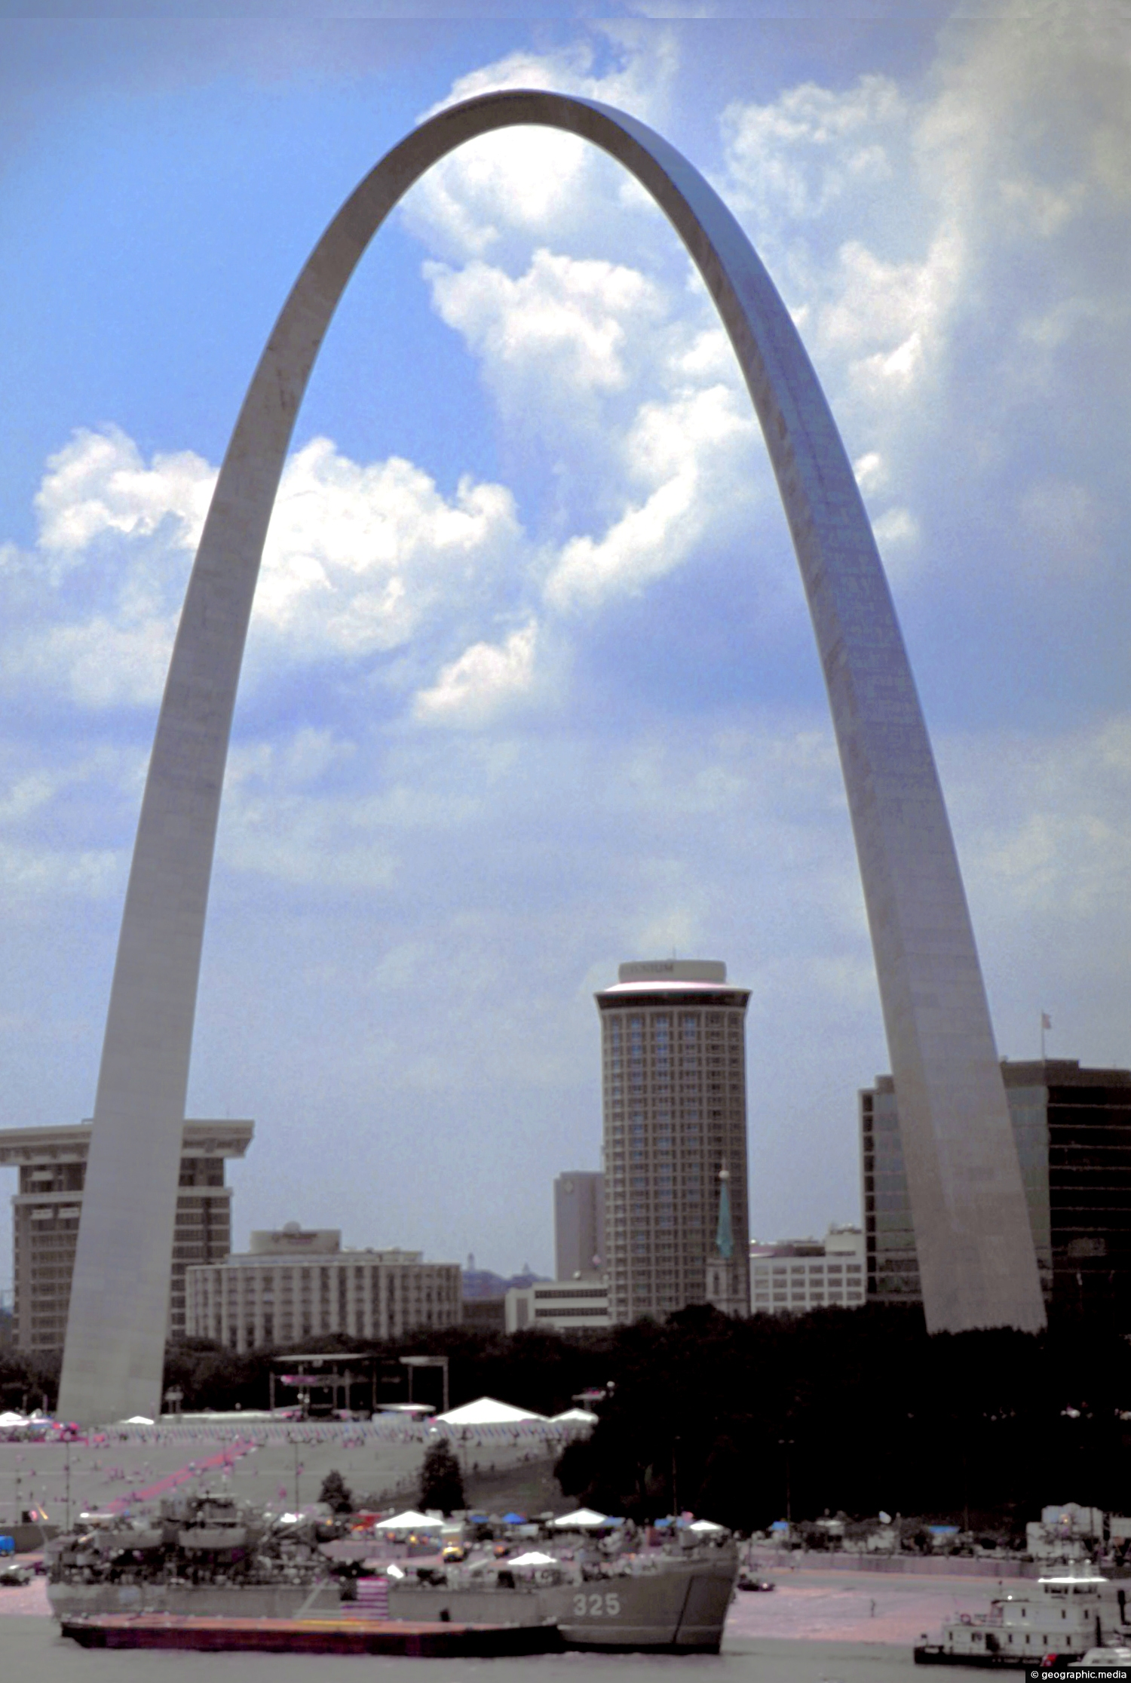
M-TRAC Annual Meeting
July 26-27
St. Louis, Missouri
Hosted by: Missouri DOT

Slide 2
Agenda
7:30 am – 8:30 am Arrival and Registration
8:30 am – 9:00 am Welcome & Participant Introductions
9:00 am – 9:15 am Update on Transportation Curriculum Coordination Council (TC3) - Chris Anderson
9:15 am – 9:45 am New Technologies – Emily Lloyd
9:45 am – 10:00 am Break
10:00 am – 10:15 am Exam On-line Security and Software – Jodi Pluemer
10:15 am – 10:30 am Missouri DOT Recertification Videos
10:30 am – 10:45 am Instruction by Live Streaming/Central Source – Chris Padilla
10:45 am – 12:00 pm State Presentations
12:00 pm – 1:00pm Lunch (provided)
1:00 pm – 1:45 pm Handling Training and Certification Post-Covid – State Participation
1:45 pm – 2:15 pm State Presentations
2:15 pm – 2:30 pm Break
2:30 pm – 3:00 pm AASHTOWARE Who’s In-Who’s Out – Committee Discussion Donna, Brian, Jodi/Ken
3:00 pm – 3:15 pm M-TRAC Update – Chris Anderson
3:15 pm – 4:00 pm Instructor Retirement and Replacement – Brian Squier

Slide 3
Agenda
7:00 am – 8:00 am Breakfast (provided)
8:00 am – 8:45 am Administration Details–Finances/Materials to Students/Registration DetailsBrian/Donna
8:45 am – 9:30 am FHWA Update – Dennis Dvorak
9:30 am – 10:00 am NICET and ACI Updates – Ahmed Farouki/John Nehasil
10:00 am – 10:15 am New Certifications – Who has new certifications?
10:15 am – 10:30 am Break
10:30 am – 11:00 am State Presentations
11:00 am – 11:45 am Open Discussion
11:45 am – 12:00 am Workshop Wrap-Up/Location for M-TRAC Workshop 2023

